Slide 1
PRESENTED BY
Future AI Leaders
[Presenter Name]
AI Innovation
Academy 2025
Training Program

Slide 2
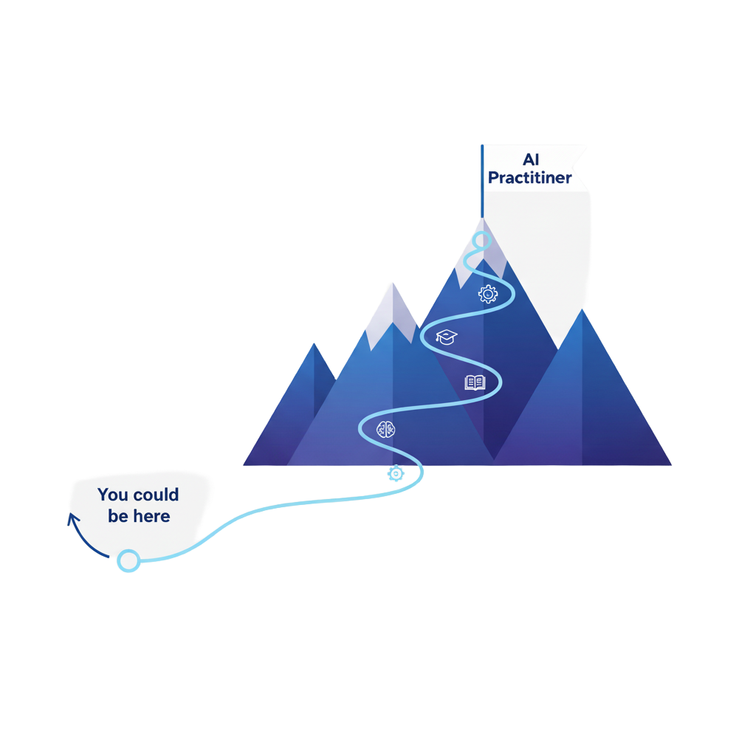

What's Our Goal? 🎯
To equip you with the foundational skills and practical experience to solve real-world problems using AI and Machine Learning
Key Takeaways :
You will learn the theory, but more importantly, you will build things.
This is a hands-on, project-based program.
We are a community, learn from us and from each other.

Slide 3
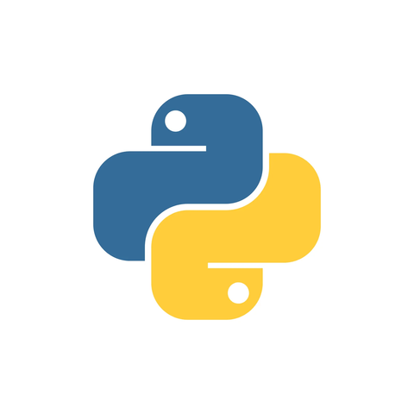


Orientation & Intro to AI/ML
What You'll Cover:
Introduction to AI/ML: What is it, really? And Key concepts.
Applications & Impact: How AI is changing industries from healthcare, finance, education, etc.
Tools Overview: Your toolkit for the course: Python, Jupyter Notebooks, and Google Colab.

Slide 4
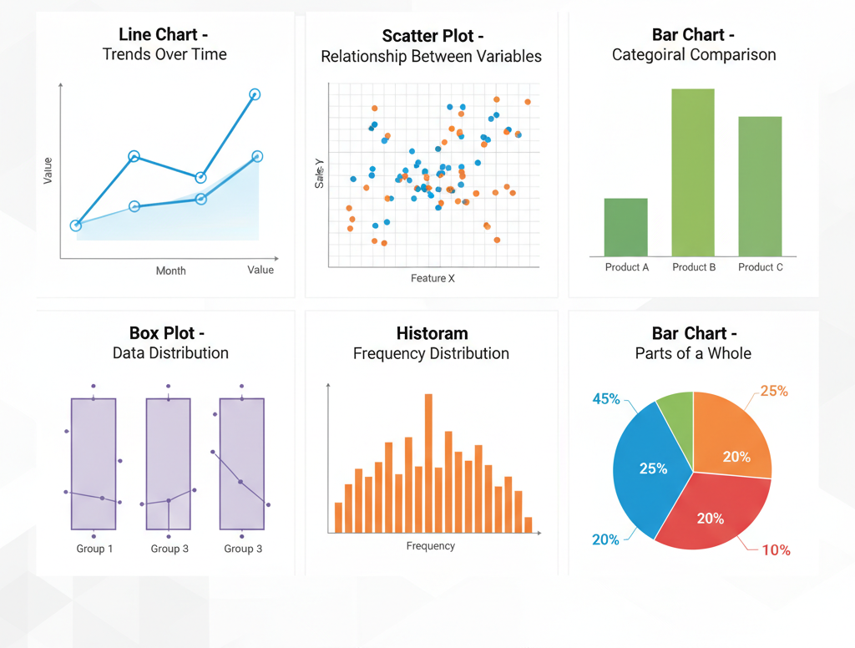
Data Manipulation & Visualization
Data is at the heart of AI. In this module, you will gain essential skills in data manipulation and visualization using libraries like NumPy, Pandas, and Matplotlib to extract insights.

Slide 5
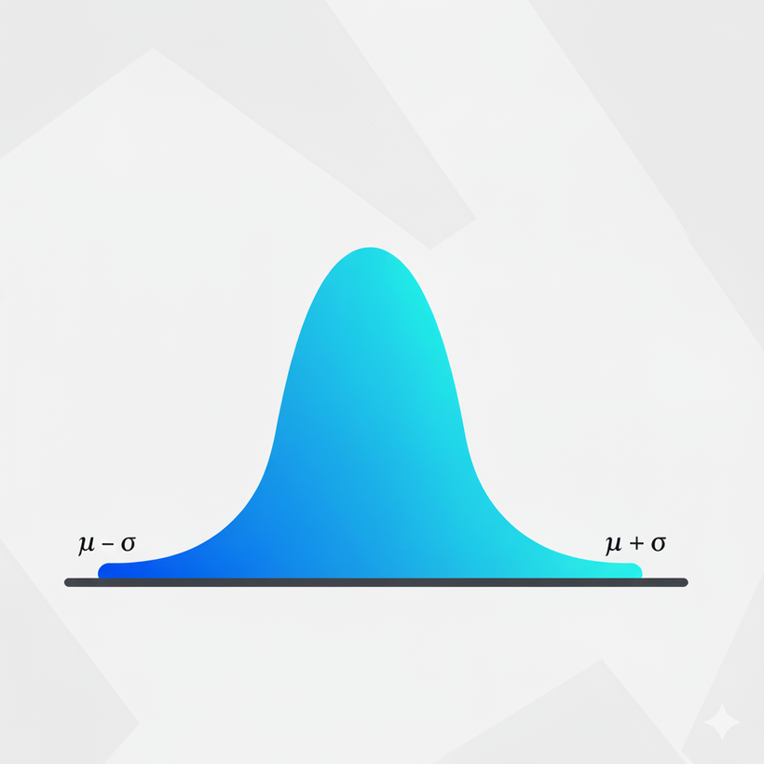
Statistics & Probability
Understanding the foundations of statistics and probability is essential for developing robust machine learning models.
What You'll Cover:
Descriptive Statistics: Summarizing data with concepts like mean, median, and variance.
Probability & Distributions: Understanding likelihood and common data patterns.
Hypothesis Testing: Making data-driven decisions with statistical confidence.

Slide 6
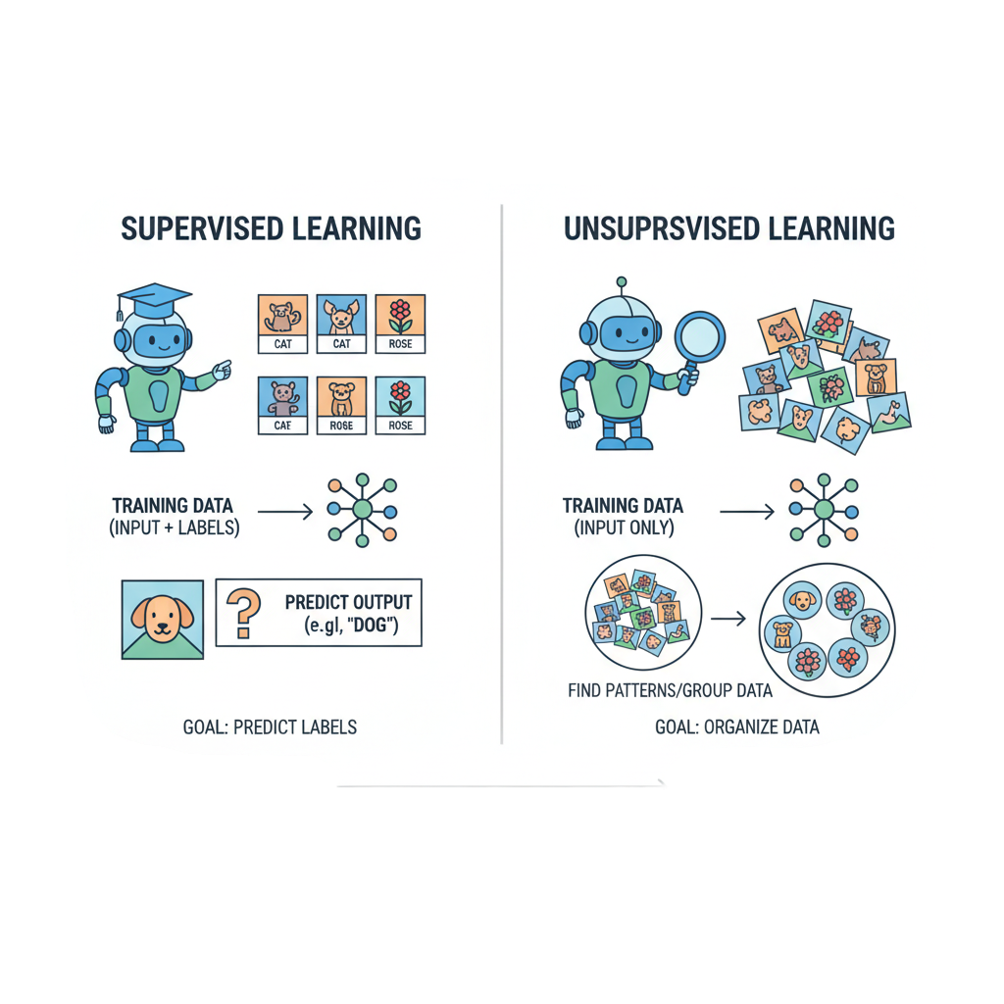
Learning Algorithms
SUPERVISED LEARNING
Learn patterns using labeled data.
Regression: Predicting continuous values (e.g., house prices).
Classification: Predicting categories (e.g., spam or not spam).
UNSUPERVISED LEARNING
Discover hidden structures in data without labels.
Clustering: Grouping similar data points together.
Dimensionality Reduction: Simplifying complex data without losing key information

Slide 7
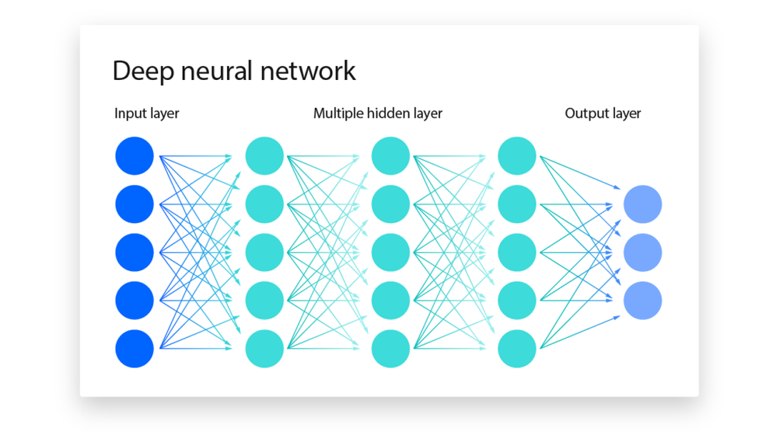
Deep Learning Fundamentals
What You'll Cover:
Neural Networks: Understanding the building blocks (neurons, layers, activation functions).
PyTorch Introduction: Getting hands-on with a leading deep learning framework.
Building Simple Models: You will construct and train your first neural network
https://www.ibm.com/think/topics/ai-vs-machine-learning-vs-deep-learning-vs-neural-networks

Slide 8
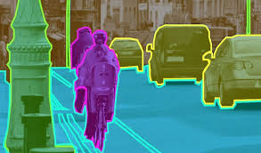
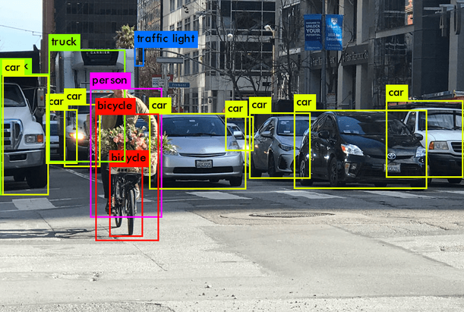
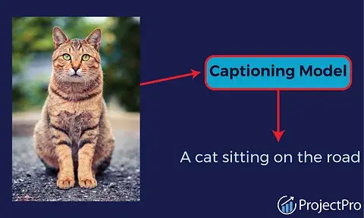
Computer Vision
You'll learn how to train models to interpret and understand information from images. We will cover Classification, Object Detection and Segmentation.

Slide 9
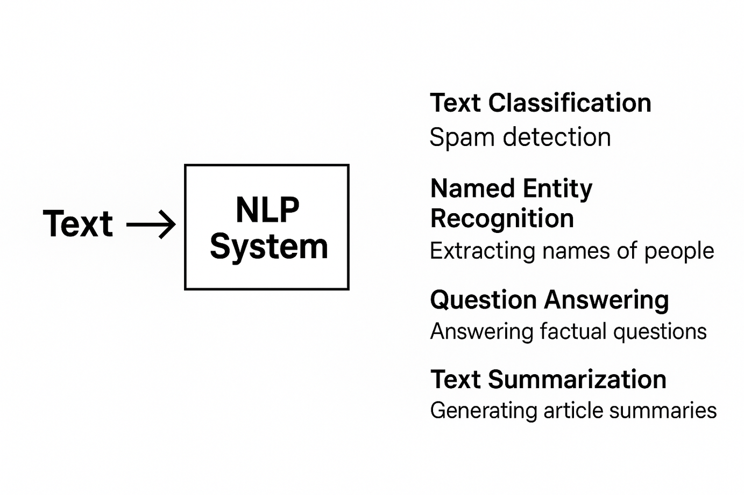
Natural Language Processing
You will learn how to process, analyze, and extract meaning from text data, enabling computers to understand language.

Slide 10


LLMs, Fine-Tuning & RAG
What You'll Cover:
HuggingFace & APIs: Using pre-trained models from the world's largest AI community.
Prompt Engineering: Designing and refining your prompts to get useful and accurate responses from LLMs.
Retrieval-Augmented Generation (RAG): Extend LLM capabilities by connecting them to your own data sources.

Slide 11
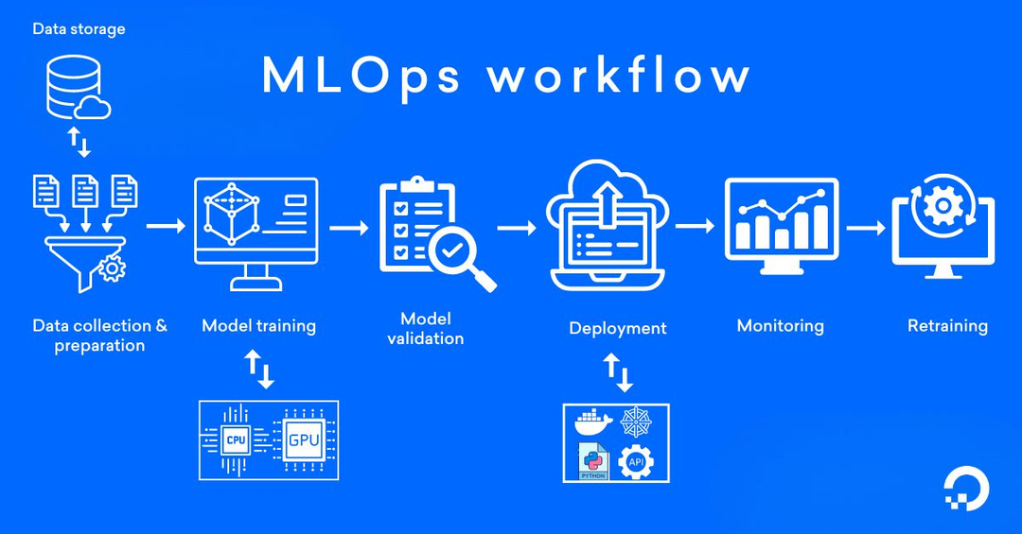
Deployment & MLOps
A model sitting in a notebook isn't useful. You'll learn how to package and deploy your models so people can actually use them
What You'll Cover:
Containerization: Using Docker to make your models portable.
Experiment Tracking: Managing your work with MLFlow and DVC.
Serving Models: Building simple web apps with Flask / FastAPI.
Monitoring: Keeping an eye on your model's performance in the wild.
https://www.digitalocean.com/resources/articles/mlops

Slide 12
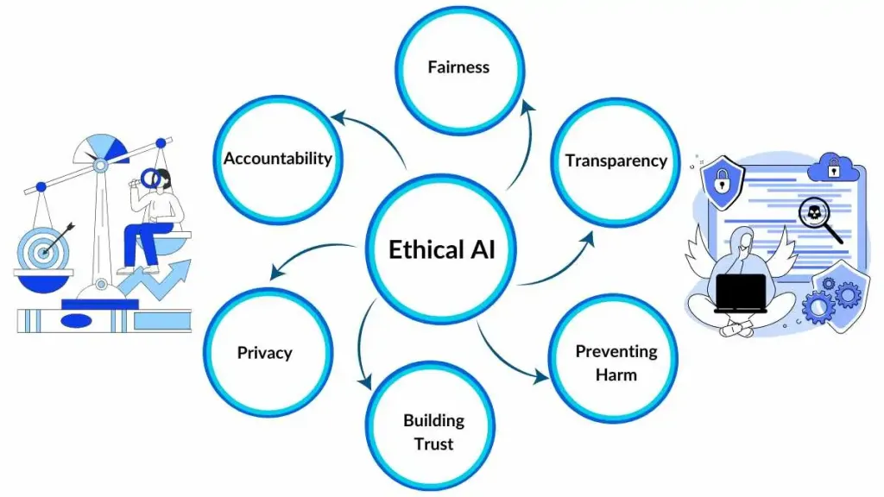
AI Ethics & Responsible AI
With great power comes great responsibility. We will critically examine how to build AI systems that are fair, safe, and transparent.
What You'll Cover:
Bias & Fairness: How to identify and mitigate harmful biases in data and models.
Data Privacy: Protecting user information and building trust.
Regulatory Frameworks: Understanding the rules of the road for AI.
https://spotintelligence.com/2024/07/30/ethical-ai-explained-key-issues-practical-how-to-implement-guide/

Slide 13

Project Week
You will apply everything you've learned to a topic you're passionate about.
The Process:
Propose: Ideate and define a problem to solve.
Build: Work in your teams to develop your solution.
Present: Showcase your project to your peers and instructors.
Outcome: A project that demonstrates your end-to-end skills as an AI practitioner.

Slide 14

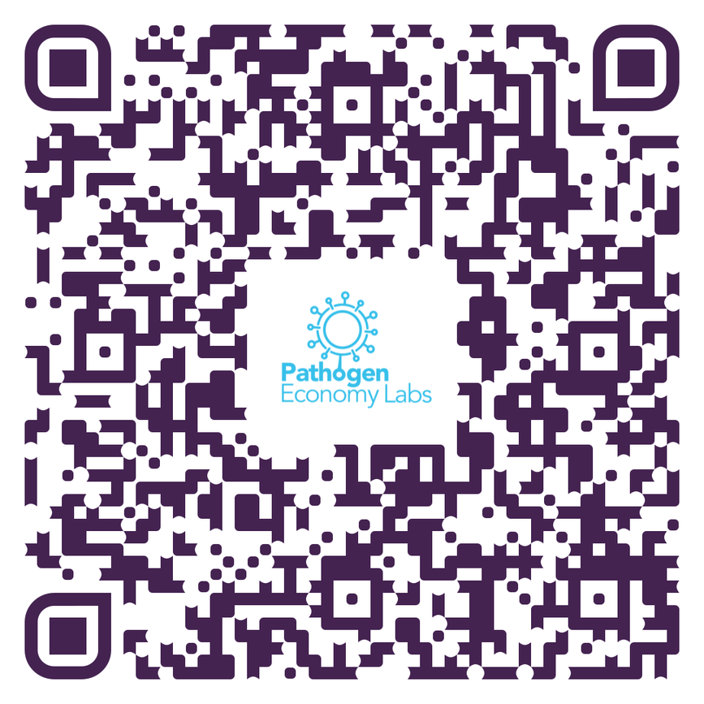
Ready to Begin?
Join the Slack Channel

